Slide 1
Loan Default Prediction Capstone Project
Yenework Mola

Slide 2
Problem Statement
The Problem:
Financial institutions suffer losses due to loan defaults.
Need to identify high risk applicants before approving loans.
Goal: Develop a predictive model to classify defaulters vs. non-defaulters
Source: HMEQ dataset (5,960 applicants)
Target: (Default: 1, Non-default: 0)
LOAN, MORTDUE, VALUE, JOB, REASON, YOJ, DEROG, DELINQ, CLAGE, NINQ, DEBTINC
Key Features:

Slide 3
Data Exploration & Preprocessing
EDA Highlights:
LOAN & MORTDUE are right-skewed
High-value applicants carry higher risk
BAD variable is imbalanced (80% non-default, 20% default)
Preprocessing Steps:
Imputed missing values with mode
One-hot encoding of categorical variables

Slide 4
Modeling Approach
Algorithms Implemented:
Logistic Regression
Decision Tree
Random Forest
Metrics: Precision, Recall, Accuracy, F1 Score

Slide 5
Chosen Model - Random Forest Outperformed others in accuracy & F1 Handles non-linear relationships well Balanced precision-recall Best suited for capturing default risk patterns
Model | Accuracy | Precision | Recall | F1 Score
Logistic Regression | 0.85 | 0.75 | 0.40 | 0.52
Decision Tree | 0.86 | 0.61 | 0.76 | 0.68
Random forest | 0.89 | 0.70 | 0.76 | 0.73

Slide 6
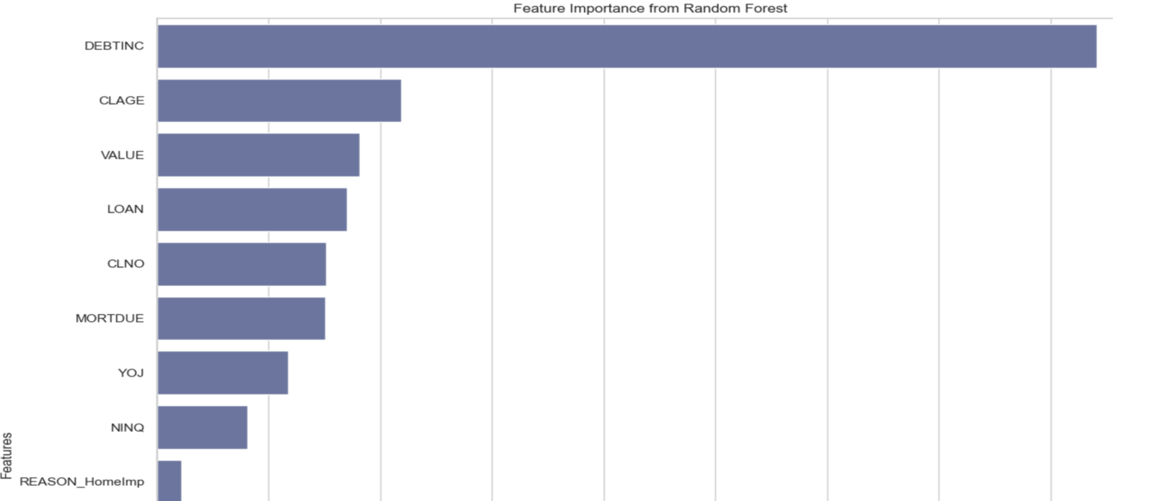
Top Predictors:
DEBTINC (Debt-to-Income Ratio)
CLAGE (Credit Line Age)
VALUE (Property Value)
LOAN (Loan Amount)

Slide 7
Business Impact
Predict defaulters early to reduce risk
Improve approval decisions
Retain profitable customers

Slide 8
Summary
Loan default prediction is feasible and effective
Random Forest is a reliable choice
Strong predictors identified for risk profiling
Business can expect improved decision making and fewer defaults
Expected benefits include lower default-related losses and greater operational efficiency. Risks involve potential bias, overfitting, and resistance to adoption. Next steps should focus on ongoing validation and testing the model across different borrower segments.

Slide 9
Best Metrics for Imbalanced Datasets:
Metric | Why It’s Good
Precision | Tells you how many predicted positives were actually correct – helps reduce false alarms (e.g., wrongly accusing someone of fraud)
Recall | Tells how many actual positives caught – helps make sure you don’t miss the rare but important cases
F1 Score | A balanced measure that combines Precision and Recall – good when you need both to be high

